Slide 1

Project Alpha
Kevin Unruh

Slide 2
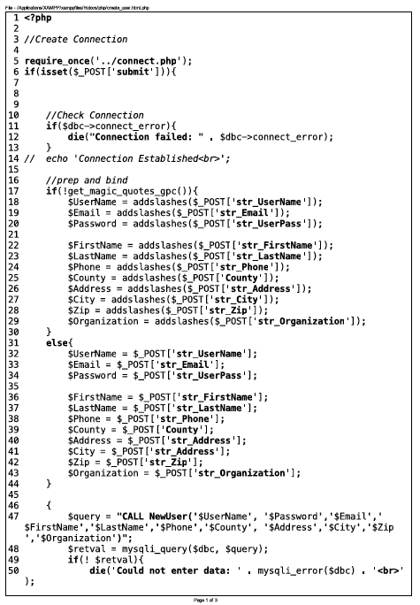
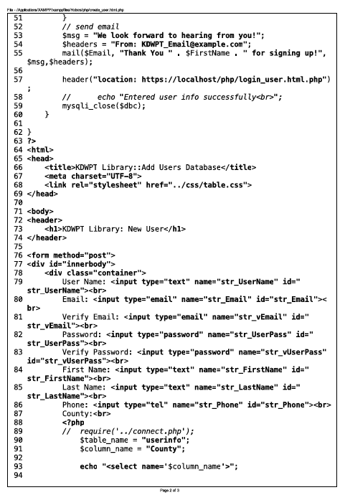

Slide 3


Slide 4
